Slide 1
Sliced optimal partial transport
Yikun Bai & Dr. Soheil Kolouri
Vanderbilt University

Slide 2





Introduction of Optimal transport
$$c(x,y)$$
$$x$$
$$y$$
$$ν$$
$$μ$$

Slide 3
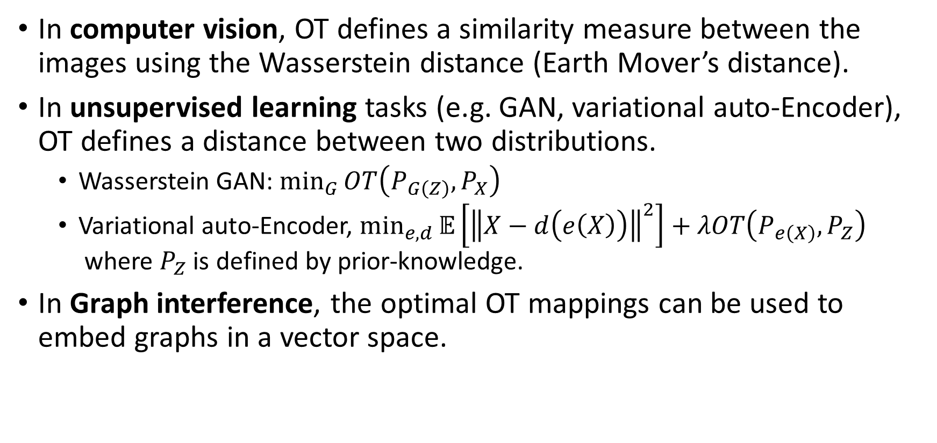
Applications of OT
In computer vision, OT defines a similarity measure between the images using the Wasserstein distance (Earth Mover’s distance).
In unsupervised learning tasks (e.g. GAN, variational auto-Encoder), OT defines a distance between two distributions.
Wasserstein GAN: $\min_{G}{OT\left(P_{G\left(Z\right)},P_{X}\right)}$
Variational auto-Encoder, $\min_{e,d}{𝔼\left[{\left\|X−d\left(e\left(X\right)\right)\right\|}^{2}\right]+λOT\left(P_{e\left(X\right)},P_{Z}\right)}$ where $P_{Z}$ is defined by prior-knowledge.
In Graph interference, the optimal OT mappings can be used to embed graphs in a vector space.

Slide 4

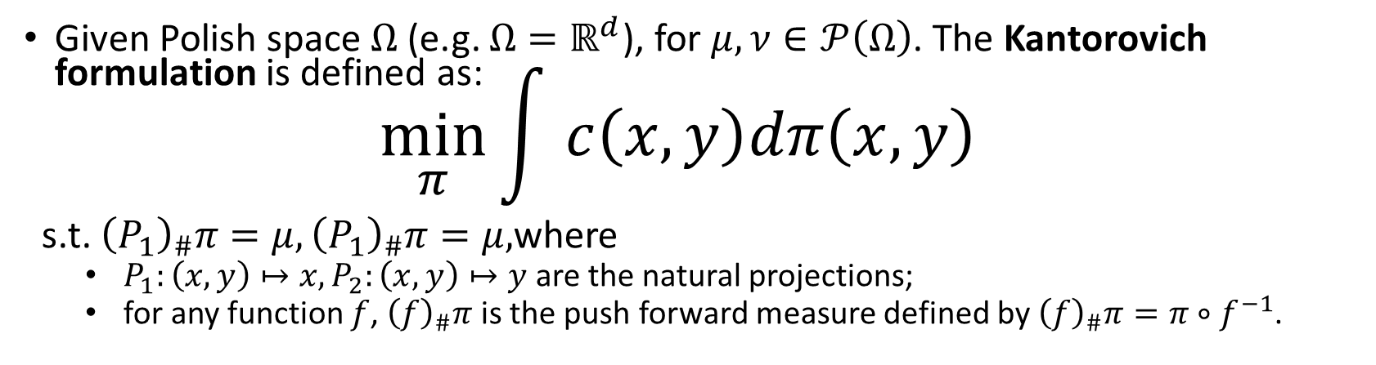

Kantorovich formulation
Given Polish space $Ω$ (e.g. $Ω=ℝ^{d}$), for $μ,ν∈𝒫\left(Ω\right)$. The Kantorovich formulation is defined as: $\min_{π}{\int{ c\left(x,y\right)dπ\left(x,y\right)}}$
s.t. ${\left(P_{1}\right)}_{\#}π=μ,{\left(P_{1}\right)}_{\#}π=μ,$where
$P_{1}:\left(x,y\right)↦x,P_{2}:\left(x,y\right)↦y$ are the natural projections;
for any function $f$, ${\left(f\right)}_{\#}π$ is the push forward measure defined by ${\left(f\right)}_{\#}π=π∘f^{−1}$.
$$μ$$
$$ν$$

Slide 5
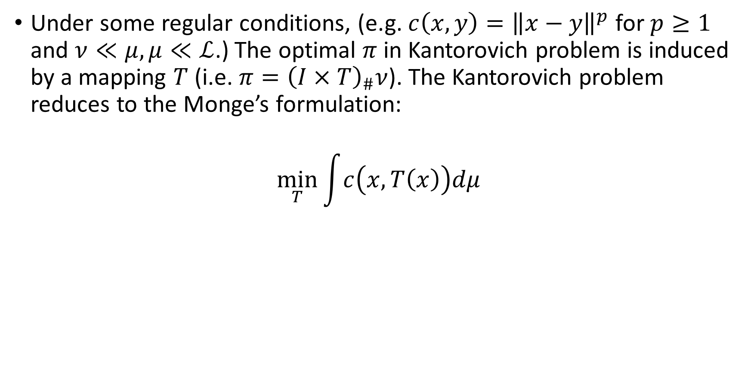
Monge’s formulation
Under some regular conditions, (e.g. $c\left(x,y\right)={\left\|x−y\right\|}^{p}$ for $p≥1$ and $ν≪μ,μ≪ℒ$.) The optimal $π$ in Kantorovich problem is induced by a mapping $T$ (i.e. $π={\left(I×T\right)}_{\#}ν$). The Kantorovich problem reduces to the Monge’s formulation:
$$\min_{T}{\int{c\left(x,T\left(x\right)\right)dμ}}$$

Slide 6


Optimal partial transport (OPT)
$$μ$$
$$ν$$

Slide 7


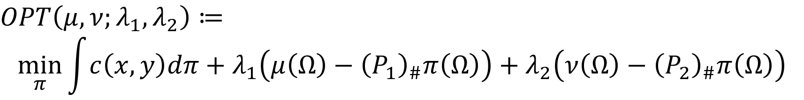
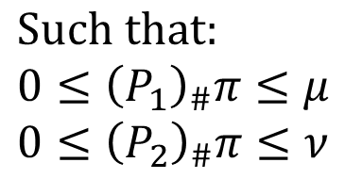
Formulation of OPT
$OPT\left(μ,ν;λ_{1},λ_{2}\right)≔$
$$\min_{π}{\int{c\left(x,y\right)dπ}+λ_{1}\left(μ\left(Ω\right)−{\left(P_{1}\right)}_{\#}π\left(Ω\right)\right)+λ_{2}\left(ν\left(Ω\right)−{\left(P_{2}\right)}_{\#}π\left(Ω\right)\right)}$$
transportation
cost
mass destruction penalty
mass creation penalty
$$Such that: \\ 0≤{\left(P_{1}\right)}_{\#}π≤μ \\ 0≤{\left(P_{2}\right)}_{\#}π≤ν$$
where $λ_{1},λ_{2}≥0$ are constant.
When $λ_{1}=λ_{2}$, we denoted as $OPT\left(μ,ν;λ\right)$.

Slide 8
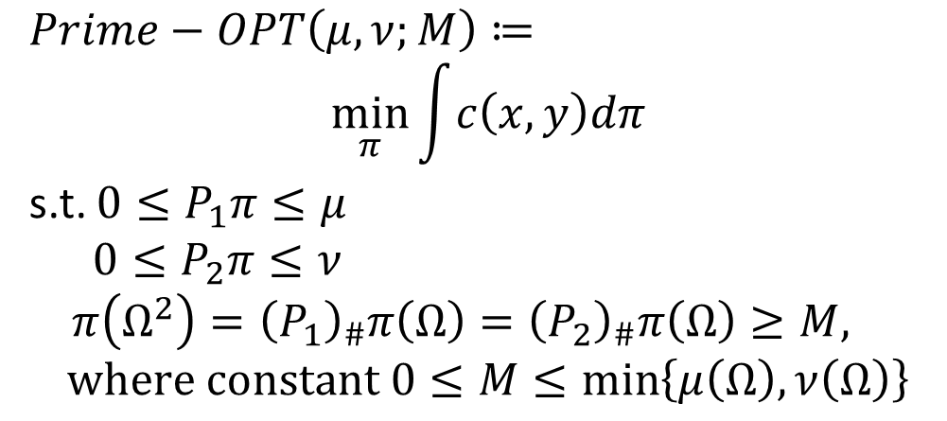

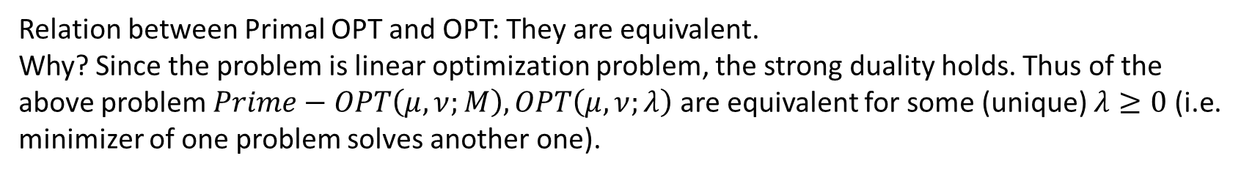
History of formulations of OPT
$$Primal form OPT:$$
$Prime−OPT\left(μ,ν;M\right)≔$ $$\min_{π}{\int{c\left(x,y\right)dπ}}$$
s.t. $0≤P_{1}π≤μ$
$0≤P_{2}π≤ν$
$π\left(Ω^{2}\right)={\left(P_{1}\right)}_{\#}π\left(Ω\right)={\left(P_{2}\right)}_{\#}π\left(Ω\right)≥M,$
$$where constant 0≤M≤\min\left\{μ\left(Ω\right),ν\left(Ω\right)\right\}$$
Relation between Primal OPT and OPT: They are equivalent. Why? Since the problem is linear optimization problem, the strong duality holds. Thus of the above problem $Prime−OPT\left(μ,ν;M\right),OPT\left(μ,ν;λ\right)$ are equivalent for some (unique) $λ≥0$ (i.e. minimizer of one problem solves another one).

Slide 9
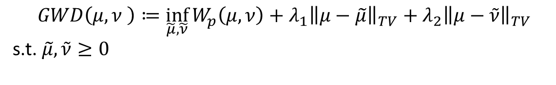
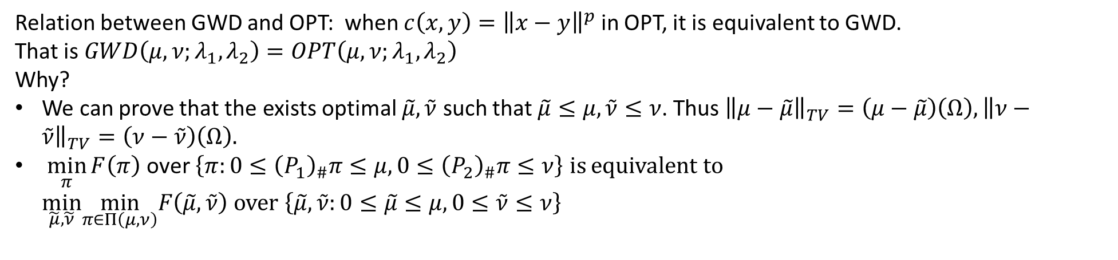
History of formulations of OPT
$$Generalized Wasserstein distance:$$
$$GWD\left(μ,ν \right)≔\inf_{\tilde{μ},\tilde{ν}}{W_{p}\left(μ,ν\right)+λ_{1}{\left\|μ−\tilde{μ}\right\|}_{TV}+λ_{2}{\left\|μ−\tilde{ν}\right\|}_{TV}}$$
s.t. $\tilde{μ},\tilde{ν}≥0$
Relation between GWD and OPT: when $c\left(x,y\right)={\left\|x−y\right\|}^{p}$ in OPT, it is equivalent to GWD. That is $GWD\left(μ,ν;λ_{1},λ_{2}\right)=OPT\left(μ,ν;λ_{1},λ_{2}\right)$ Why?
We can prove that the exists optimal $\tilde{μ},\tilde{ν}$ such that $\tilde{μ}≤μ,\tilde{ν}≤ν$. Thus ${\left\|μ−\tilde{μ}\right\|}_{TV}=\left(μ−\tilde{μ}\right)\left(Ω\right),{\left\|ν−\tilde{ν}\right\|}_{TV}=\left(ν−\tilde{ν}\right)\left(Ω\right).$
$\min_{π}{F\left(π\right)}$ over $\left\{π:0≤{\left(P_{1}\right)}_{\#}π≤μ,0≤{\left(P_{2}\right)}_{\#}π≤ν\right\}$ is equivalent to $\min_{\tilde{μ},\tilde{ν}}\min_{π∈Π\left(μ,ν\right)}F\left(\tilde{μ},\tilde{ν}\right)$ over $\left\{\tilde{μ},\tilde{ν}:0≤\tilde{μ}≤μ,0≤\tilde{ν}≤ν\right\}$

Slide 10
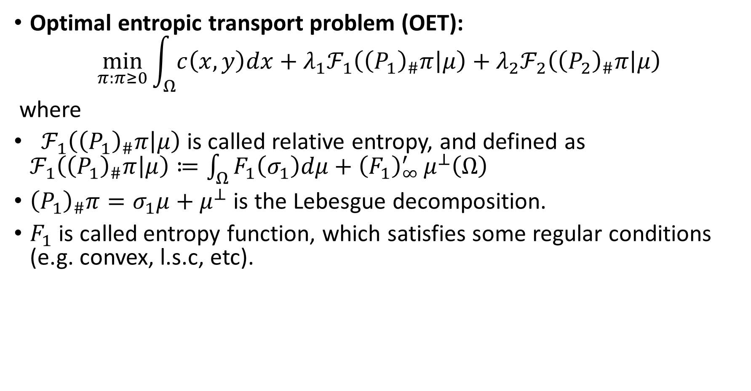
Generalization of OPT: Unbalanced OT
Optimal entropic transport problem (OET):
$$\min_{π:π≥0}{\int_{Ω}{c\left(x,y\right)dx}+λ_{1}ℱ_{1}\left({\left(P_{1}\right)}_{\#}π | μ\right)+λ_{2}ℱ_{2}\left({\left(P_{2}\right)}_{\#}π | μ\right)}$$
where
$ℱ_{1}\left({\left(P_{1}\right)}_{\#}π | μ\right)$ is called relative entropy, and defined as $ℱ_{1}\left({\left(P_{1}\right)}_{\#}π | μ\right)≔\int_{Ω}{F_{1}\left(σ_{1}\right)dμ+{\left(F_{1}\right)}_{∞}^{′}}μ^{⊥}\left(Ω\right)$
${\left(P_{1}\right)}_{\#}π=σ_{1}μ+μ^{⊥}$ is the Lebesgue decomposition.
$F_{1}$ is called entropy function, which satisfies some regular conditions (e.g. convex, l.s.c, etc).

Slide 11
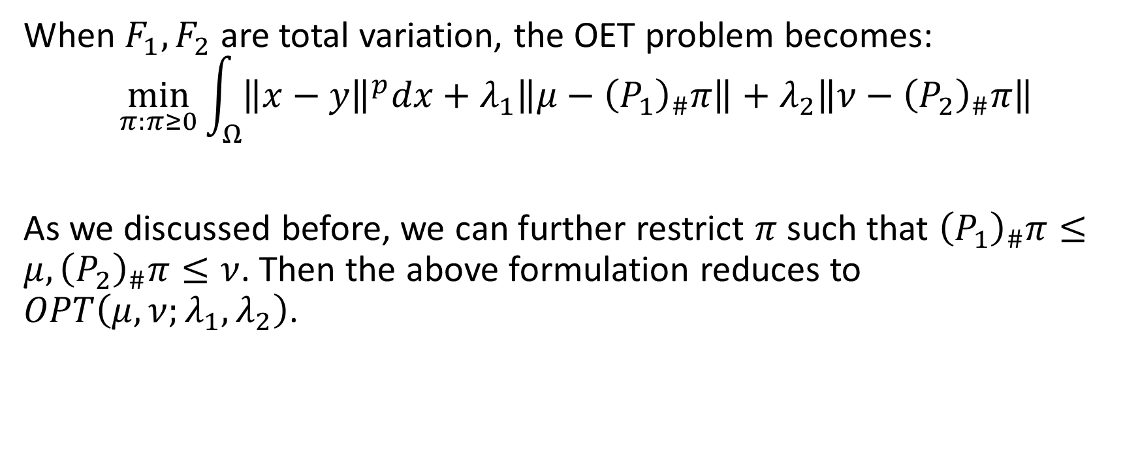
Relation between OET and OPT
When $F_{1},F_{2}$ are total variation, the OET problem becomes:
$$\min_{π:π≥0}{\int_{Ω}{{\left\|x−y\right\|}^{p}dx}+λ_{1}\left\|μ−{\left(P_{1}\right)}_{\#}π\right\|+λ_{2}\left\|ν−{\left(P_{2}\right)}_{\#}π\right\|}$$
As we discussed before, we can further restrict $π$ such that ${\left(P_{1}\right)}_{\#}π≤μ,{\left(P_{2}\right)}_{\#}π≤ν$. Then the above formulation reduces to $OPT\left(μ,ν;λ_{1},λ_{2}\right)$.

Slide 12
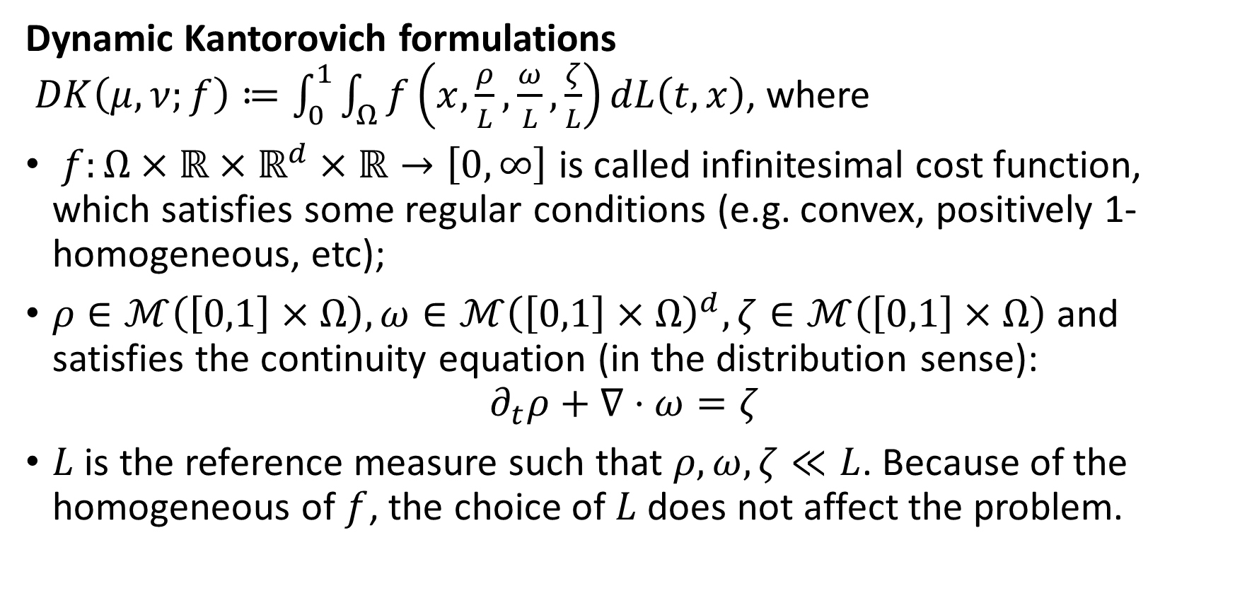
Generalization of OPT: Unbalanced OT
Dynamic Kantorovich formulations $DK\left(μ,ν;f\right)≔\int_{0}^{1}{\int_{Ω}{f\left(x,\frac{ρ}{L},\frac{ω}{L},\frac{ζ}{L}\right)dL\left(t,x\right)}}$, where
$f:Ω×ℝ×ℝ^{d}×ℝ→\left[0,∞\right]$ is called infinitesimal cost function, which satisfies some regular conditions (e.g. convex, positively 1-homogeneous, etc);
$ρ∈ℳ\left(\left[0,1\right]×Ω\right),ω∈ℳ{\left(\left[0,1\right]×Ω\right)}^{d},ζ∈ℳ\left(\left[0,1\right]×Ω\right)$ and satisfies the continuity equation (in the distribution sense):
$$∂_{t}ρ+∇⋅ω=ζ$$
$L$ is the reference measure such that $ρ,ω,ζ≪L$. Because of the homogeneous of $f$, the choice of $L$ does not affect the problem.

Slide 13
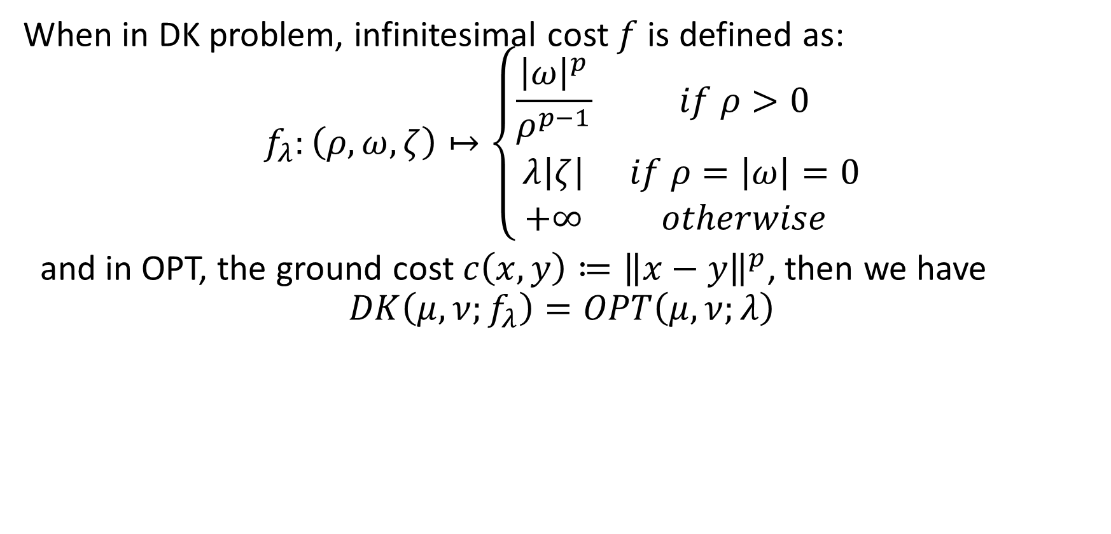
Relation between DK and OPT
When in DK problem, infinitesimal cost $f$ is defined as: $$f_{λ}:\left(ρ,ω,ζ\right)↦\left\{\begin{matrix}\frac{{\left|ω\right|}^{p}}{ρ^{p−1}} & if ρ>0 \\ λ\left|ζ\right| & if ρ=\left|ω\right|=0 \\ +∞ & otherwise\end{matrix}\right.$$
and in OPT, the ground cost $c\left(x,y\right)≔{\left\|x−y\right\|}^{p}$, then we have $$DK\left(μ,ν;f_{λ}\right)=OPT\left(μ,ν;λ\right)$$

Slide 14
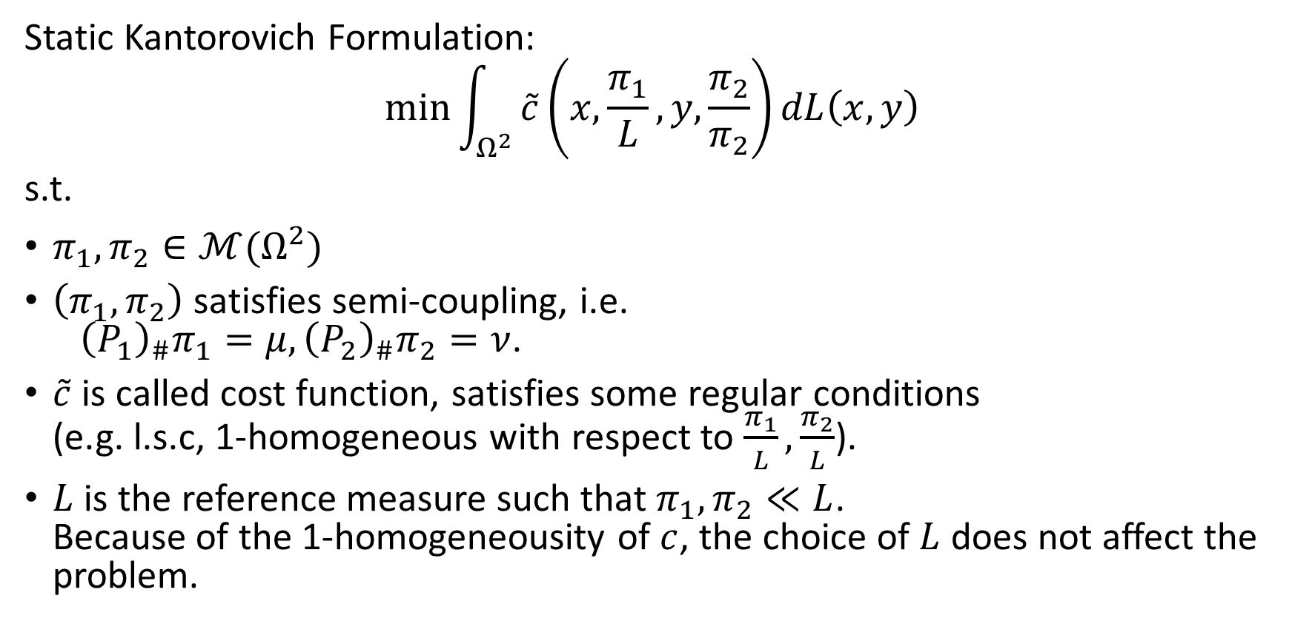
Generalization of OPT: Unbalanced OT
Static Kantorovich Formulation:
$$\min{\int_{Ω^{2}}{\tilde{c}\left(x,\frac{π_{1}}{L},y,\frac{π_{2}}{π_{2}}\right)dL\left(x,y\right)}}$$
s.t.
$π_{1},π_{2}∈ℳ(Ω^{2})$
$\left(π_{1},π_{2}\right)$ satisfies semi-coupling, i.e. ${\left(P_{1}\right)}_{\#}π_{1}=μ,{\left(P_{2}\right)}_{\#}π_{2}=ν$.
$\tilde{c}$ is called cost function, satisfies some regular conditions (e.g. l.s.c, 1-homogeneous with respect to $\frac{π_{1}}{L},\frac{π_{2}}{L}$).
$L$ is the reference measure such that $π_{1},π_{2}≪L$. Because of the 1-homogeneousity of $c$, the choice of $L$ does not affect the problem.

Slide 15
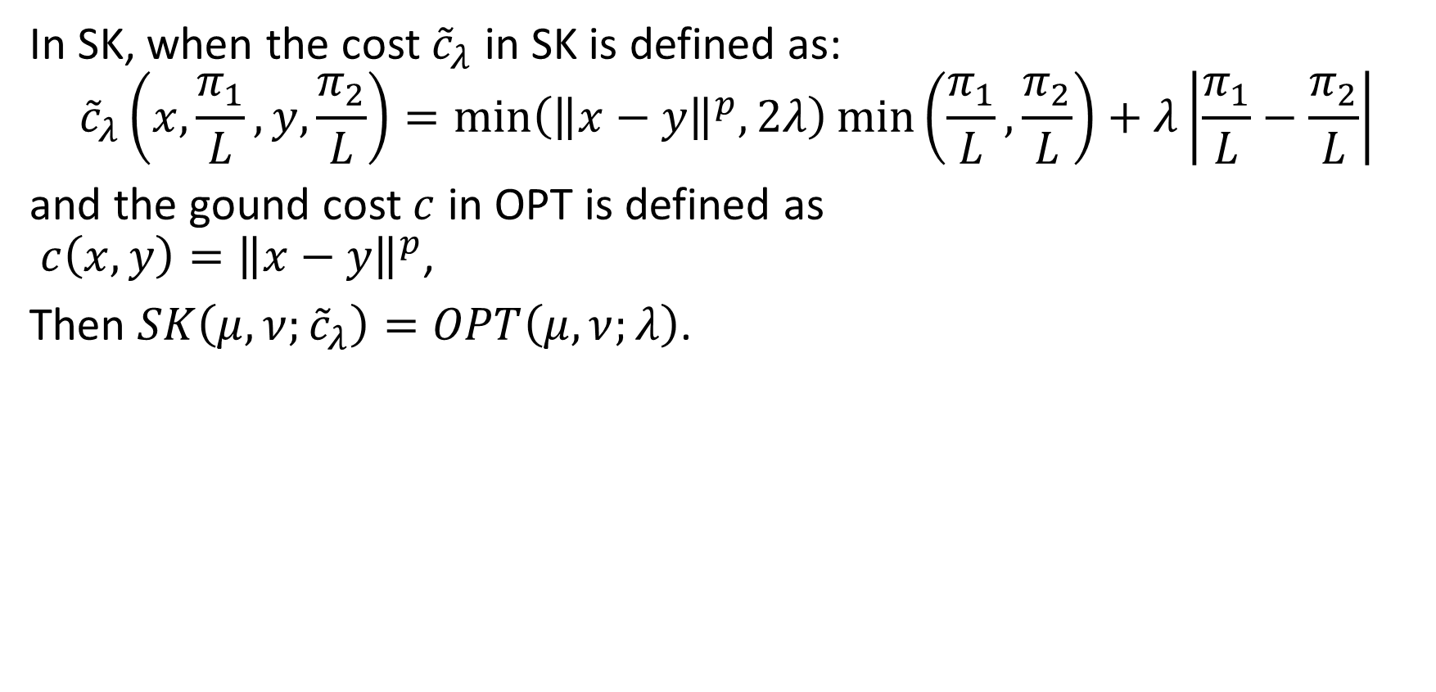
Relation between SK and OPT
In SK, when the cost ${\tilde{c}}_{λ}$ in SK is defined as: $${\tilde{c}}_{λ}\left(x,\frac{π_{1}}{L},y,\frac{π_{2}}{L}\right)=\min\left({\left\|x−y\right\|}^{p},2λ\right)\min\left(\frac{π_{1}}{L},\frac{π_{2}}{L}\right)+λ\left|\frac{π_{1}}{L}−\frac{π_{2}}{L}\right|$$
and the gound cost $c$ in OPT is defined as $c\left(x,y\right)={\left\|x−y\right\|}^{p}$,
Then $SK\left(μ,ν;{\tilde{c}}_{λ}\right)=OPT\left(μ,ν;λ\right)$.

Slide 16
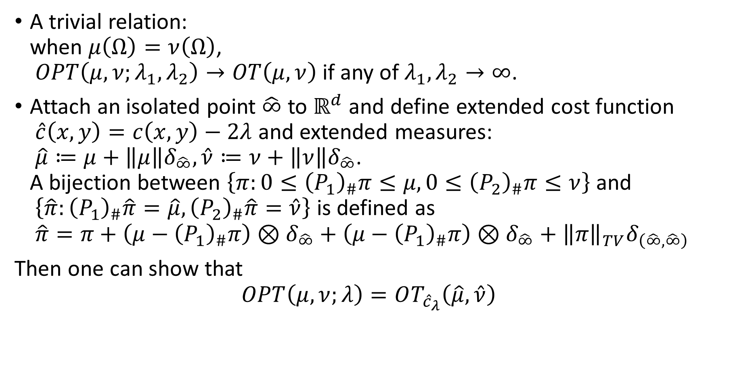
Relation of OT and OPT
A trivial relation: when $μ\left(Ω\right)=ν\left(Ω\right)$, $OPT\left(μ,ν;λ_{1},λ_{2}\right)→OT\left(μ,ν\right)$ if any of $λ_{1},λ_{2}→∞$.
Attach an isolated point $\hat{∞}$ to $ℝ^{d}$ and define extended cost function $\hat{c}\left(x,y\right)=c\left(x,y\right)−2λ$ and extended measures: $\hat{μ}≔μ+\left\|μ\right\|δ_{\hat{∞}},\hat{ν}≔ν+\left\|ν\right\|δ_{\hat{∞}}$. A bijection between $\left\{π:0≤{\left(P_{1}\right)}_{\#}π≤μ,0≤{\left(P_{2}\right)}_{\#}π≤ν\right\}$ and $\left\{\hat{π}:{\left(P_{1}\right)}_{\#}\hat{π}=\hat{μ},{\left(P_{2}\right)}_{\#}\hat{π}=\hat{ν}\right\}$ is defined as $\hat{π}=π+\left(μ−{\left(P_{1}\right)}_{\#}π\right)⊗δ_{\hat{∞}}+\left(μ−{\left(P_{1}\right)}_{\#}π\right)⊗δ_{\hat{∞}}+{\left\|π\right\|}_{TV}δ_{\left(\hat{∞},\hat{∞}\right)}$
Then one can show that
$$OPT\left(μ,ν;λ\right)=OT_{{\hat{c}}_{λ}}\left(\hat{μ},\hat{ν}\right)$$

Slide 17




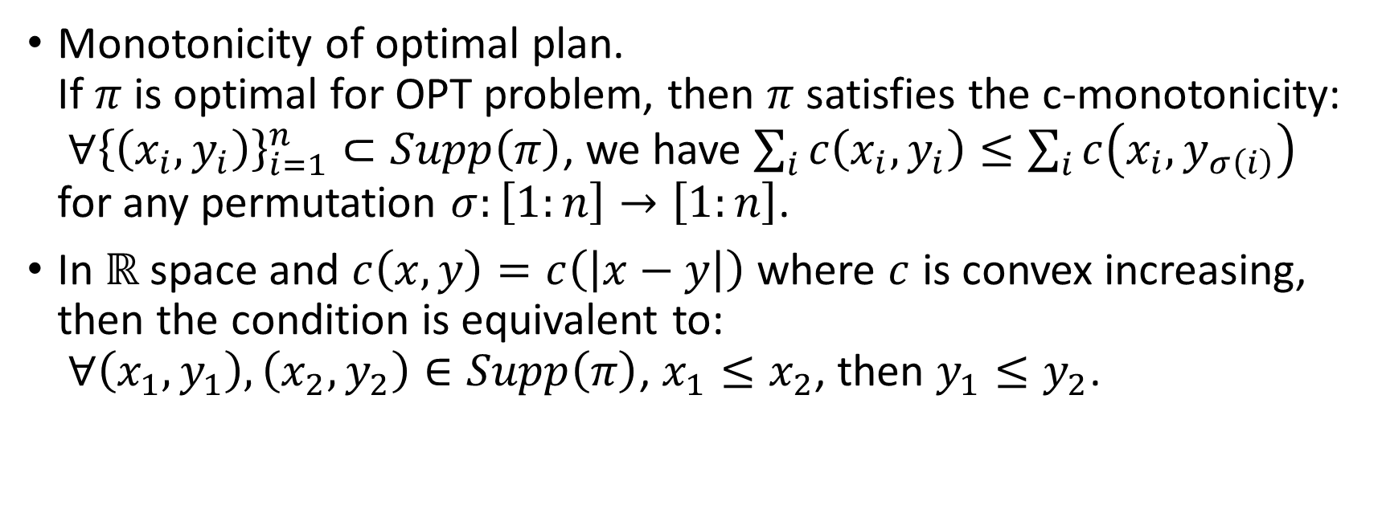


Basic properties of OPT
Monotonicity of optimal plan. If $π$ is optimal for OPT problem, then $π$ satisfies the c-monotonicity: $∀{\left\{\left(x_{i},y_{i}\right)\right\}}_{i=1}^{n}⊂Supp\left(π\right)$, we have $\sum_{i}{c\left(x_{i},y_{i}\right)}≤\sum_{i}{c\left(x_{i},y_{σ\left(i\right)}\right)}$ for any permutation $σ:\left[1:n\right]→\left[1:n\right]$.
In $ℝ$ space and $c\left(x,y\right)=c\left(\left|x−y\right|\right)$ where $c$ is convex increasing, then the condition is equivalent to: $∀\left(x_{1},y_{1}\right),\left(x_{2},y_{2}\right)∈Supp\left(π\right)$, $x_{1}≤x_{2}$, then $y_{1}≤y_{2}$.
$$X$$
$$X$$
$$Y$$
$$Y$$

Slide 18
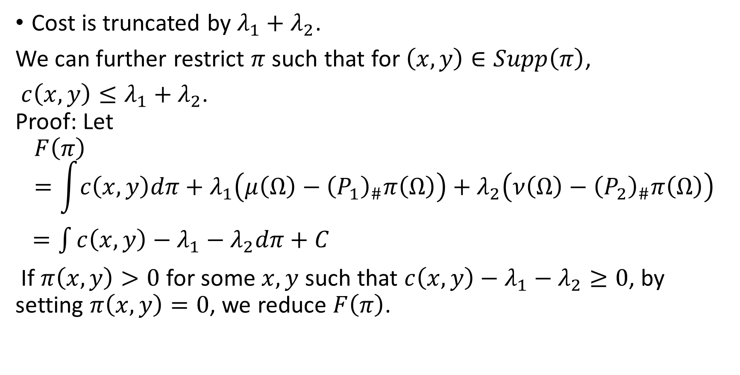
Basic properties of OPT
Cost is truncated by $λ_{1}+λ_{2}$.
We can further restrict $π$ such that for $\left(x,y\right)∈Supp\left(π\right)$,
$c\left(x,y\right)≤λ_{1}+λ_{2}$. Proof: Let
$$F\left(π\right)=\int{c\left(x,y\right)dπ}+λ_{1}\left(μ\left(Ω\right)−{\left(P_{1}\right)}_{\#}π\left(Ω\right)\right)+λ_{2}\left(ν\left(Ω\right)−{\left(P_{2}\right)}_{\#}π\left(Ω\right)\right)$$
$=\int{c\left(x,y\right)−λ_{1}−λ_{2}dπ}+C$
If $π\left(x,y\right)>0$ for some $x,y$ such that $c\left(x,y\right)−λ_{1}−λ_{2}≥0$, by setting $π\left(x,y\right)=0$, we reduce $F\left(π\right)$.

Slide 19
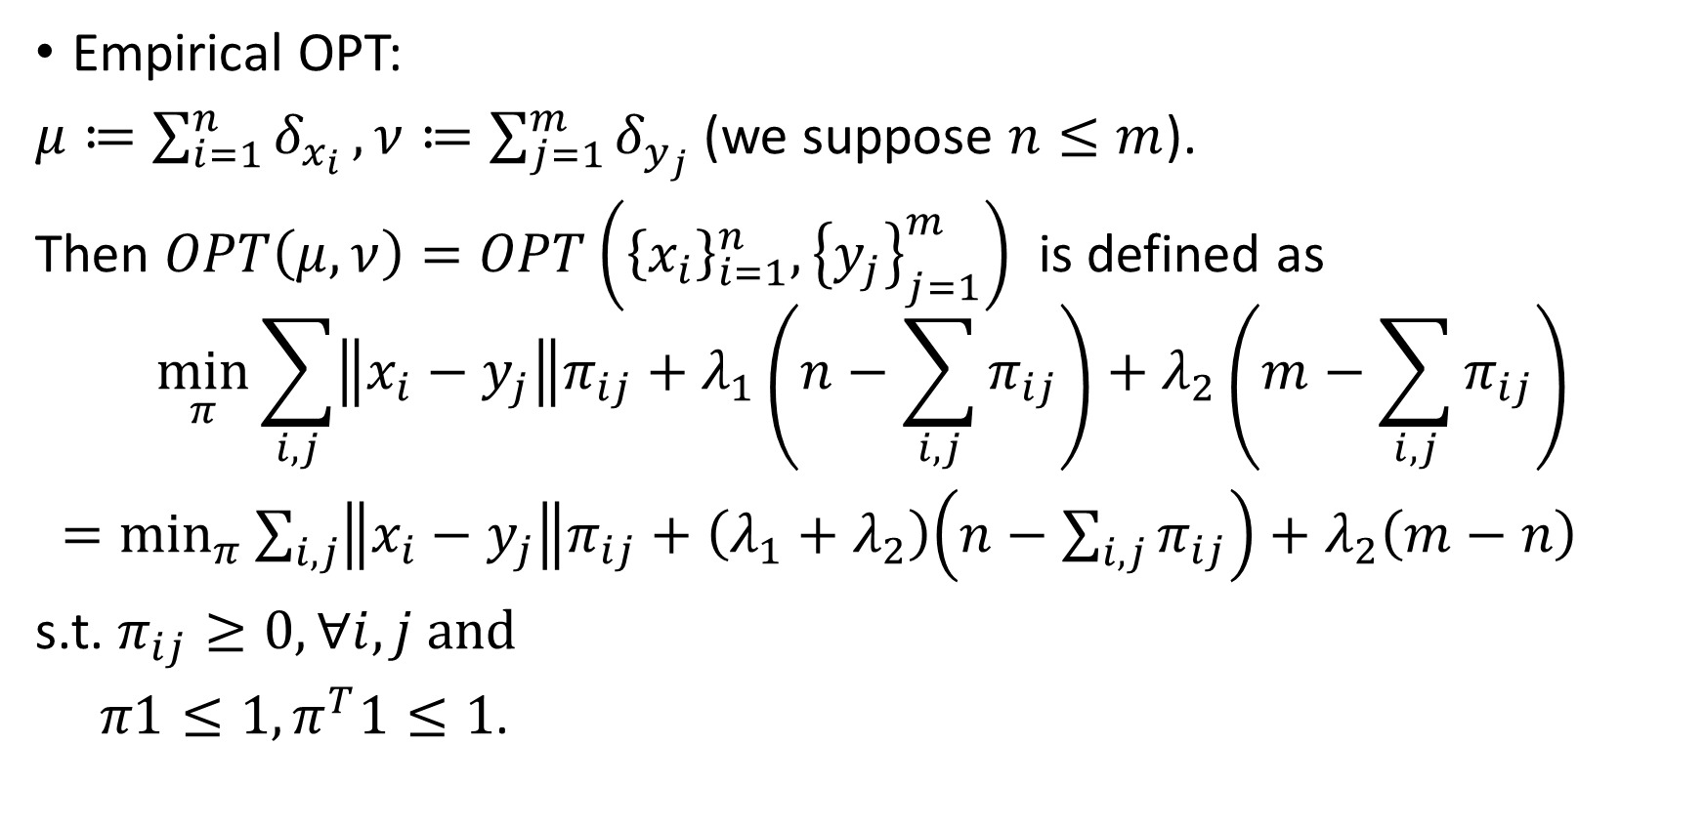
Computation of Empirical OPT
Empirical OPT:
$μ≔\sum_{i=1}^{n}{δ_{x_{i}}},ν≔\sum_{j=1}^{m}{δ_{y_{j}}}$ (we suppose $n≤m$).
Then $OPT\left(μ,ν\right)=OPT\left({\left\{x_{i}\right\}}_{i=1}^{n},{\left\{y_{j}\right\}}_{j=1}^{m}\right)$ is defined as
$$\min_{π}{\sum_{i,j}{\left\|x_{i}−y_{j}\right\|π_{ij}}+λ_{1}\left(n−\sum_{i,j}{π_{ij}}\right)+λ_{2}\left(m−\sum_{i,j}{π_{ij}}\right)}$$
$=\min_{π}{\sum_{i,j}{\left\|x_{i}−y_{j}\right\|π_{ij}}+\left(λ_{1}+λ_{2}\right)\left(n−\sum_{i,j}{π_{ij}}\right)+λ_{2}\left(m−n\right)}$
s.t. $π_{ij}≥0,∀i,j$ and
$π1≤1,π^{T}1≤1$.

Slide 20
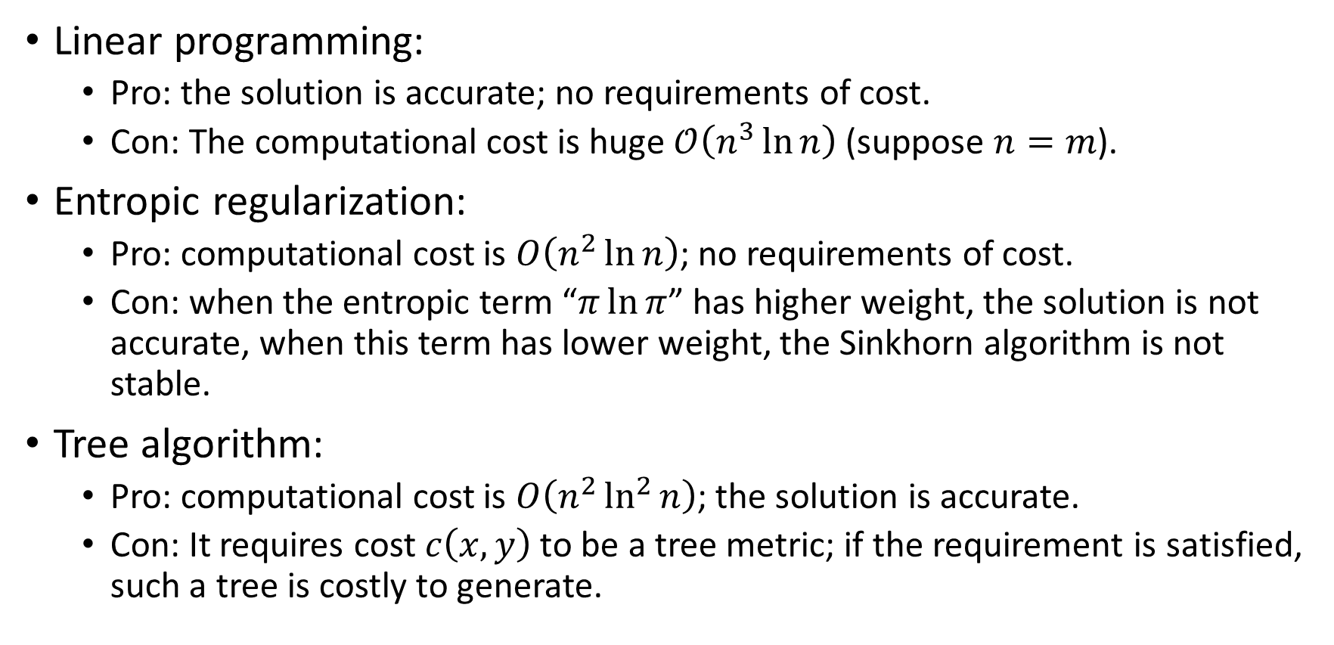
Computation of Empirical OPT
Linear programming:
Pro: the solution is accurate; no requirements of cost.
Con: The computational cost is huge $𝒪\left(n^{3}\ln{n}\right)$ (suppose $n=m$).
Entropic regularization:
Pro: computational cost is $O\left(n^{2}\ln{n}\right)$; no requirements of cost.
Con: when the entropic term “$π\ln{π}$” has higher weight, the solution is not accurate, when this term has lower weight, the Sinkhorn algorithm is not stable.
Tree algorithm:
Pro: computational cost is $O\left(n^{2}\ln^{2}{n}\right)$; the solution is accurate.
Con: It requires cost $c\left(x,y\right)$ to be a tree metric; if the requirement is satisfied, such a tree is costly to generate.

Slide 21
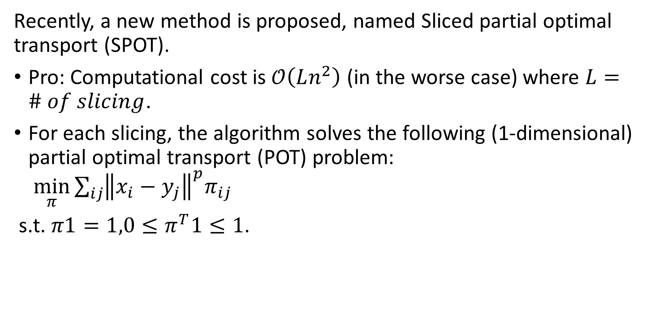
Sliced Partial Optimal Transport
Recently, a new method is proposed, named Sliced partial optimal transport (SPOT).
Pro: Computational cost is $𝒪\left(Ln^{2}\right)$ (in the worse case) where $L=\# of slicing$.
For each slicing, the algorithm solves the following (1-dimensional) partial optimal transport (POT) problem: $\min_{π}{\sum_{ij}{{\left\|x_{i}−y_{j}\right\|}^{p}π_{ij}}}$
s.t. $π1=1,0≤π^{T}1≤1$.

Slide 22

Relation between OPT and POT
A trivial relation:
for any one of $λ_{1},λ_{2}→∞$,
$OPT\left({\left\{x_{i}\right\}}_{i=1}^{n},{\left\{y_{j}\right\}}_{j=1}^{m}\right)−λ_{2}\left(n−m\right)$
.$→POT\left({\left\{x_{i}\right\}}_{i=1}^{n},{\left\{y_{j}\right\}}_{j=1}^{m}\right)$

Slide 23
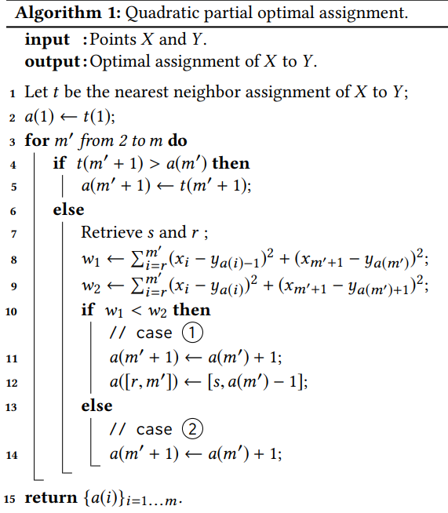





















Algorithm of 1D-POT
$$X$$
$$x_{r}$$
$$x_{k−1}$$
$$x_{k}$$
$$Y$$
$$y_{s}$$
$$y_{l}$$
case 1:
$$X$$
$$x_{r}$$
$$x_{k−1}$$
$$x_{k}$$
$$Y$$
$$y_{l}$$
$$y_{s}$$
case 2:
$$X$$
$$x_{r}$$
$$x_{k−1}$$
$$x_{k}$$
$$Y$$
$$y_{l}$$
$$y_{s}$$

